Slide 1
Project Presentation eBusiness Financial Gateway
ECO-IT, ITMB, HP GDDC
Project Lead: Shan Ying
27 Oct. 2005

Slide 2
Agenda
Project Background
  Project Brief
  Technology, Tools, Reused components
  Organizational Structure
  Lifecycle, Current Phase
Project Management
  Project Plan
  Estimate
  Lifecycle Selection, PDSP & Tailoring
  Risk Plan
  Quality Plan, Metrics Collection
  Training Plan
  Communication Plan

Slide 3
Agenda
Engineering Activities
  Requirement Development & Management
  Technical Solutions
  Project Integration
  Test Plans, Strategy, Results
  Technical Reviews
  Validation
Support Activities
  Causal Analysis and Resolution
  Decision Analysis and Resolution
  Configuration Management
  Process and Product Quality Assurance
  Project Process improvement activities

Slide 4
Project Background - Brief
Project Goal
Hewlett-Packard ECO-IT eBusiness Financial Gateway has several application projects running in Development, Test, and Production. These applications require technical analysis, quality software development deliverables, and support activities. HP GDCC will provide offshore delivery of software development tasks, analysis, and support deliverables which will be determined by the HP ECO-IT Financial Gateway development team located in US. Houston.
Project scope
Some deliverables for Financial Gateway including design, implementation, and testing.
Customer/stakeholder GOIT ECO-IT eBusiness IT
Schedule
Start Date Jul. 2005
Planned End Date May. 2006
Estimated Duration 11
Size
Estimated Efforts 55 man month
Estimated Cost
Peak Team size 5

Slide 5
Project Background - Technology
Domain: eBusiness & Finance
Platform: Windows 2000/NT/XP
Technology :J2EE, .Net, Web Service.
Tools:
Weblogic server, Weblogic workshop, Eclipse
MS Visual Studio .Net
SQL Server 2000
CVS, VSS

Slide 6
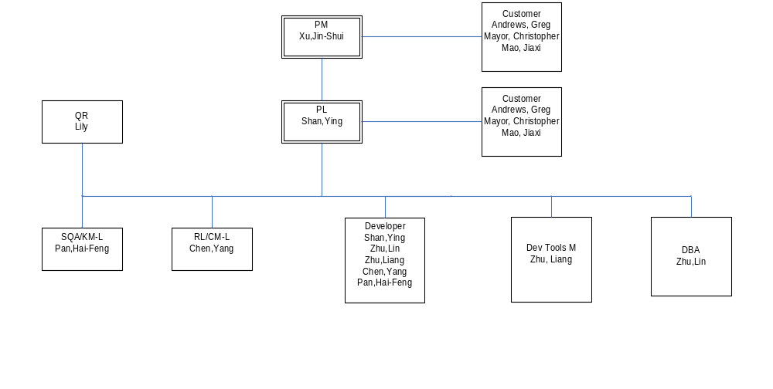
Project Background - Structure

Slide 7
Project Background – Lifecycle
Use Maintenance
Current Phase:
PGS 2.1 with Fusion , FQM 1.5

Slide 8
Project Applied – IQMS or Previous Project/Release
IQMS applied in eBusiness Financial Gateway project
http://qant02.chn.hp.com/gdcc/WebSite/webpages/html/index.asp

Slide 9
Project Management – Project Plan
Milestone: Please refer Project Plan

Slide 10
Project Management – Lifecycle & PDSP
Lifecycle: Maintenance
Tailer and Waive: N/A

Slide 11
Project Management – Quality Plan
Quality Plan:
Define Customer goals, project goals
Define Action Plan, Metrics definition, Trigger for CAR etc
Follow Standards, Guidelines & Checklists defined in IQMS

Slide 12
Metrics Tracking
Effort tracking: Monthly effort track.
Schedule track: Days spent in different phases.
Productivity: Person Days for every phase for one ER.
Notes:
MA, QPM

Slide 13
Engineering - Requirements
SOW
Meeting minutes

Slide 14
Project Management –Monitoring and Control
Project MPP: N/A
Project weekly report: self-defined on cvs
Issue log and Action Log: Track all issues and actions in project.
Engineer weekly report: self-defined on cvs
Meeting Minutes: meeting Minutes.

Slide 15
Project Management –Communication Plan
Contact List & Roles
Refer to Project Plan
Communication
E-mail
Audio conference; telephone call
eBusiness Financial Gateway web site:
Other Communication

Slide 16
Engineering – Testing
N/A
Notes:
RD, REQM

Slide 17
Engineering – Validation
Different Validation Method:
Customer sign-off: ie, SOW
Customer review: ie, functional design, technical documentation, release
Customer comments/feedback: Mail, meeting minutes
Test

Slide 18
Support – Configuration Management
Audit: Every month we do an audit
Baseline: All CI

Slide 19
Support – Process and Product Quality Assurance
Monthly report by SQA
Health check by quality manager
Organizational Audit
Close NC in time

Slide 20
Q & A

Slide 21
Thank you!

